Slide 1
CSC 374/407: Computer Systems II
Lecture 9
Joseph Phillips
De Paul University
2014 January 5
Copyright © 2012 Joseph Phillips
All rights reserved

Slide 2
Overview
What is ncurses?
A text-package that lets you control text on the screen

Slide 3
ncurses
“curses” (circa 1980)
A screen package for BSD Unix from U.C. Berkeley
“ncurses” (1993)
For “new curses”
BIG IDEA:
Two screens
Virtual one written to by program
Physical one (user's terminal)
Package minimizes bandwidth by
Relying on programmer to refresh() to sync screens
Only sending over minimal number of changes needed

Slide 4
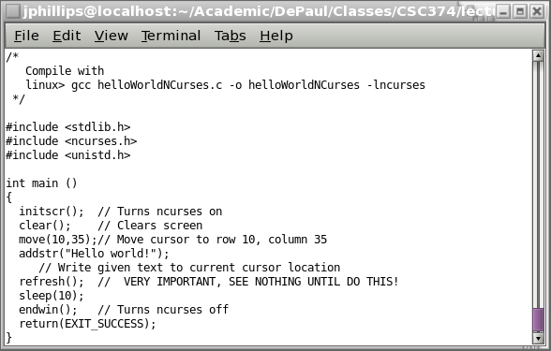
Our first ncurses program:

Slide 5
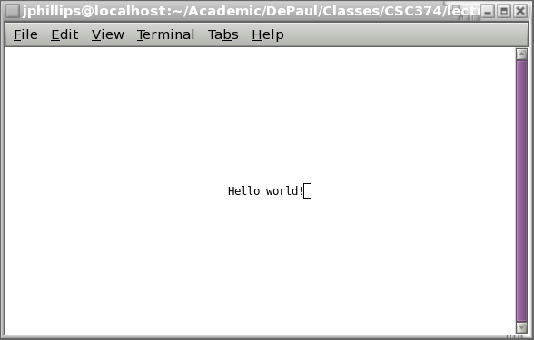
Our first ncurses program, cont'd

Slide 6
ncurses functions (1)
initscr()
Starts ncurses package
clear()
Clears screen
move(int row, int col)
Moves cursor to given row and col (upper left is 0,0)
addstr(const char* str)
Write string pointed to by str to current location
addchr(char c)
Writes character c to current location
refresh()
Sends changes need to write virtual screen to physical
endwin()
Ends ncurses package

Slide 7
Subwindows
Type WINDOW* refers to a window
stdscr refers to the whole window
Can define subwindows of whole screen

Slide 8
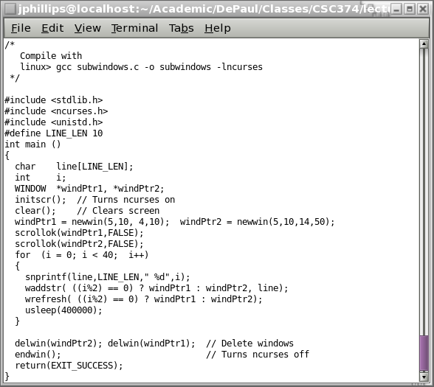
subwindows.c

Slide 9
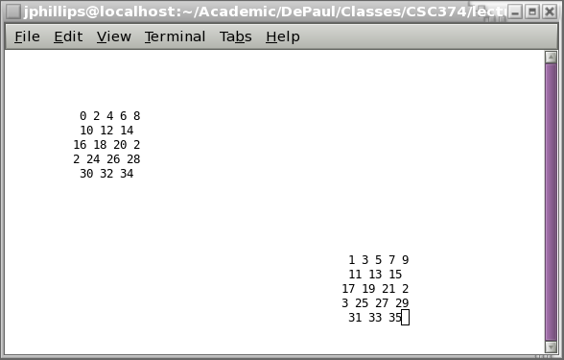
subwindow.c, cont'd

Slide 10
Using subwindows
WINDOW* newwin (int numRows, int numCols, int beginRow, int beginCol)
Makes and returns new window.
wrefresh(WINDOW* wPtr)
Refreshes just *wPtr.
delwin(WINDOW* wPtr)
Deletes *wPtr.

Slide 11
Using subwindows, cont'd
waddstr(WINDOW* wPtr, const char* str)
Writes str to *wPtr.
waddch(WINDOW* wPtr, char ch)
Writes ch to stdscr/*wPtr.
wmove(WINDOW* wPtr, int row, int col)
Moves cursor to row,col within window *wPtr.
scrollok(windowPtr, TRUE)
scrollok(windowPtr, FALSE)
Allows/disallows scrolling of window.

Slide 12
Keyboard input
Gives you more control over keyboard input
  Can get keys as they are typed, without user pressing “Enter”
  Can get arrow keys
  Can turn of “echoing” of typed chars
(When would this be good?)

Slide 13
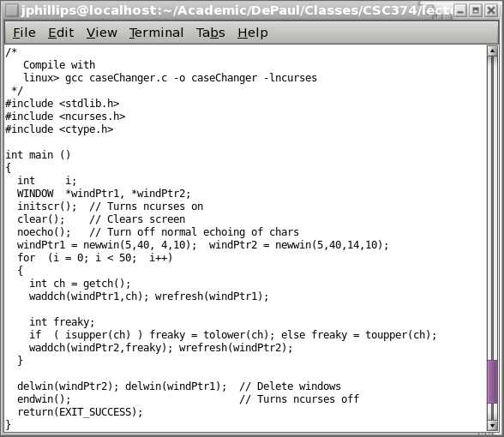
caseChanger.c

Slide 14
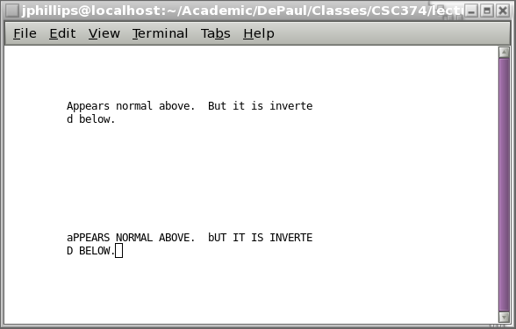
caseChanger.c cont'd

Slide 15
Misc. ncurses
int getch()
Gets key (without having to press Enter!)
If it ==ERR then no key was pressed.
noecho()
Turns off echoing of chars
nodelay(stdscr,TRUE)
Allows non-blocking input from keyboard
(Doesn't even wait for typed key)
keypad (stdscr,TRUE)
Allows keypad chars (like arrow keys)

Slide 16
YOUR TURN!
Write a program that writes a string diagonally, bouncing off the top/bottom/left/right if the string is too long.

Slide 17
Your turn, again!
Write a program that writes the text you type diagonally, bouncing off the top/bottom/left/right borders as you type it.

Slide 18
Combing sockets with ncurses
Our turn!
How would you design a Unix “talk” (or Internet “chat”) program?

